Slide 1








OBJECT ORIENTED PROGRAMMING
Introduction to OOP
by
Dr. Nor Saradatul Akmar Zulkifli
Faculty of Computer Systems & Software Engineering
saradatulakmar@ump.edu.my
OER Object Oriented Programming by Dr. Nor Saradatul Akmar Binti Zulkifli work is under licensed Creative Commons Attribution-NonCommercial-NoDerivatives 4.0 International License.

Slide 2


Content Overview
Motivation of OOP
History – Why OOP?
Difference between procedural and OO programming
Introduction to Object & Class
Four design principles of OOP

Slide 3
Learning Objective
To explain the basic of Object Oriented Programming model
To understand the differences between procedural and OO Programming
To understand the differences between class & object (instances)
To identify class & object based on the problem requirement(s)
To understand four design principles of OOP

Slide 4



Imagine airline flights
you are
given
the task of
designing an
of
reservation
system
that keeps
track
for a
commuter
airline.
List
the classes
you think
would
be necessary
for designing such
a system.
Describe the
data with
values and methods each class you
you would
associate
identify.
C.Thomas Wu Introduction to Object-Oriented Programming
Chapter 1: pg.28
HOW WILL YOU SOLVE THIS PROBLEM?

Slide 5




To solve the problem
Breaking it down into manageable pieces
Design separate pieces that are responsible
for certain parts of the solution.
2 popular programming design methods:
Procedural Programming
Object-Oriented Programming

Slide 6
PROCEDURAL VS.
OBJECT-ORIENTED
What Are The Differences??

Slide 7


PROCEDURAL
OBJECT-ORIENTED
Emphasis of program is on procedure – on HOW to accomplish a task.
Emphasis of program is on object – understanding the objects involved in a problem and how they interact
Top-down design; Step-wise refinement
Bottom-Up design; Reusable
libraries
Examples: C, COBOL, Fortran, LISP,
Perl, HTML, VBScript
Example: C++, Visual Basic.NET and JAVA
What Are The Differences??

Slide 8




Class?
Object?
INTRODUCTION TO OBJECT & CLASS
Instance of?

Slide 9











Class
Definition of objects that share structure, properties and behaviors
Skyscrapers
Class
Mosques
Class
Berries
Class
Instance
Concrete Object, Created from a certain class
KL Tower
Instance of Skyscraper
Beth Mosque
Instance of Mosque
Strawberry
Instance of Berry

Slide 10




WHAT IS AN OBJECT?
Concept : View the world as OBJECT.
A real world object is a thing, both tangible (television) and intangible (bank account)
Objects are described by using two features:
Attributes
Behaviors
ATTRIBUTE
Describe Characteristic of the object
Ex: Color, NumberofWheel, TopSpeed
BEHAVIORS
An action that an object is capable
of performing
Ex: goForward, TurnLeft, Stop

Slide 11



OBJECT : EXAMPLE
STATE
Color NumberOfDoors TopSpeed Model
: Red
: 4
: 240kmph
: Proton
OBJECT : Car
BEHAVIORS
goForward TurnLeft Stop TurnRight
TASK:
Working in pair, think of One Object and list out the State and It’s
Behaviors

Slide 12


WHAT IS A CLASS?
A class is a template that defines attributes and methods of a real-world object
It is the blueprint of an object
It contains the codes that specifies the state
and behaviors of a particular type of object
Each object that is created from a class is called an instance of the class
Multiple objects can be created from the same class during program execution & stored in the main memory
CLASS : Car

Slide 13










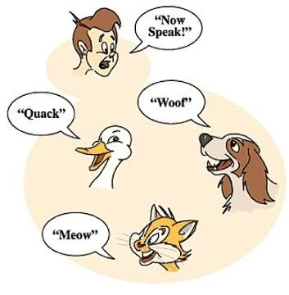
2.
Encapsulation
1.
Abstraction
3.
Inheritance
4 Design Principles
4.
Polymorphism

Slide 14






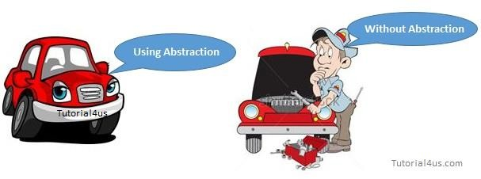
1. ABSTRACTION
A multimillionaire woman told her son that he would inherit the family fortune if he promised to continue working after she passed on. The woman dies. The money starts pouring in, and somehow the son forgets about his promise. However, a clause in her will forces him back to work.
Jim Keogh & Mario Giannini
OOP Demystified- A self teaching guide
Pg.87
A way a programmer of a super class (mom) forces a programmer of a subclass (son) to define a behavior.
The concept of exposing only the required essential characteristics and behavior with respect to a context
And hides its complexity

Slide 15



ADVANTAGE
Every user will get his own view of the data according to his requirements and will not get confused with unnecessary data
public abstract class Bank
{
private int accno; private String name; void display_to_clerk ( )
{
EXAMPLE:
System.out.println (“Account No. = “ + accno); System.out.println (“Name = “ + name);
}
void display_to_manager ( )
{
System.out.println (“Account No. = ” + accno); System.out.println (“Name = “ + name) ; System.out.println (“Loan = “ + loan); System.out.println (“Balance = “ + balance);
} }

Slide 16




2.ENCAPSULATION
The condition of being enclosed.
Enclosing “attributes” and “methods” within a class
This feature keeps the data safe from outside
interference and misuse.
Led to a concept of data hiding
Access to attributes and methods of a class is control by using Access Modifiers within a class definition
Access Modifiers is a keyword that tells what part of the program can access
attributes and methods that are members of a class.

Slide 17


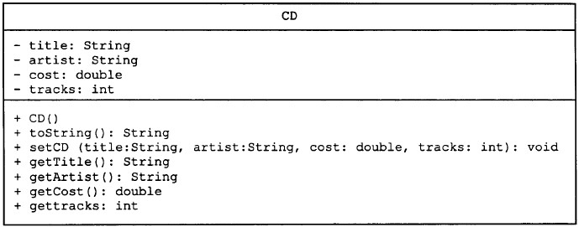
Private access assigned to the data – Keep data inaccessible to outside class
Public access – To make methods/data accessible to outside classes
Accessibility Modifier
UML Class Diagram :
Minus sign (-) used for items that are private
Plus sign (+) used for items that are public

Slide 18

ABSTRACTION VS. ENCAPSULATION
What Are The Differences??

Slide 19

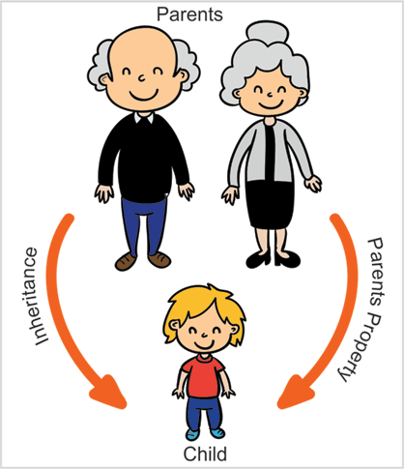
3.INHERITANCE
It enables objects to inherit attributes and
behaviors from other objects
Classes with properties in common can be grouped so that their common properties are only defined once
Superclass Vs. Subclass
ADVANTAGE
Reduce the amount of new code that must be designed, written and tested each time a new program is develop

Slide 20




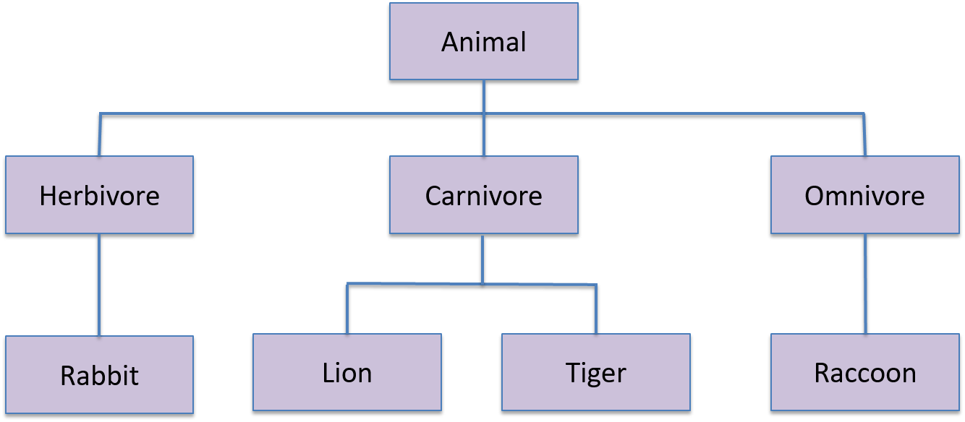
INHERITANCE : EXAMPLE

Slide 21


INHERITANCE : EXAMPLE
Parent Class (Superclass)
Feature 1
Feature 2
Feature of Parent Class
Child Class (Subclass) – inherited from Parent Class
Feature of Parent Class accessible to child class because of inheritance
Feature 1
Feature 2
Feature 3
Feature defined in Child Class

Slide 22

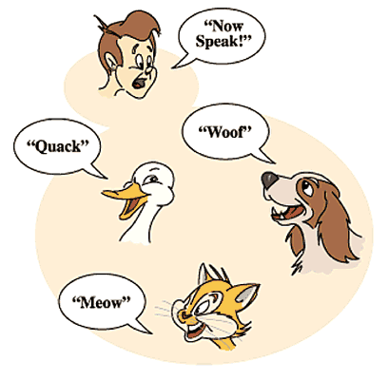
4.POLYMORPHISM
One thing has the ability to appear in many
shapes.
Programming terms:
“thing” – The name of a method
“shape” – The behavior performed by the
method
The name of a method can have many behaviors.
Allows programmer to create methods with the SAME name BUT with DIFFERENT implementation in DIFFERENT classes (that are related through inheritance)

Slide 23



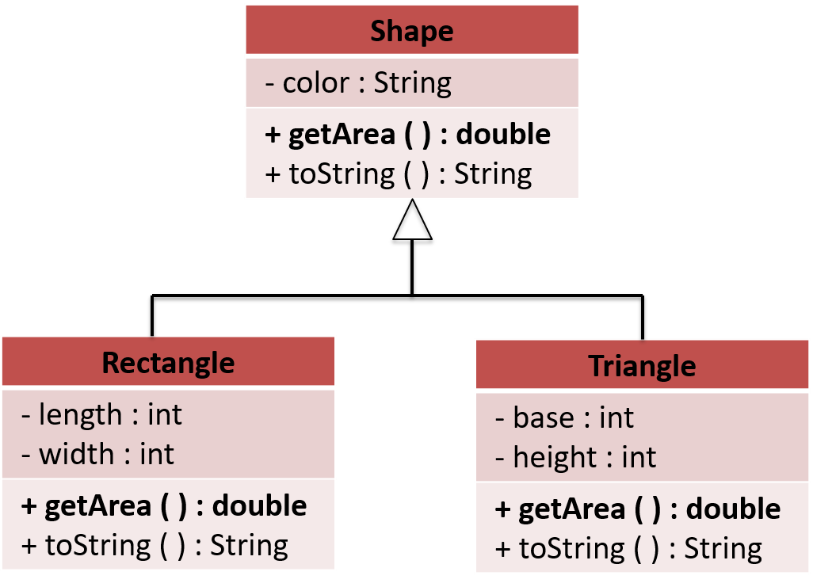
POLYMORPHISM : EXAMPLE
Superclass defines the expected
behaviors of all subclasses
Subclasses provide the actual implementations

Slide 24
E X E R C I S E
Imagine airline flights
you are
given
the task of
designing an
of
reservation
system
that keeps
track
for a
commuter
airline.
List
the classes
you think
would
be necessary
for designing such
a system.
Describe the
data with
values and methods each class you
you would
associate
identify.
C.Thomas Wu Introduction to Object-Oriented Programming
The OBJECTIVE of this Exercise is to give you a taste of thinking about a program at a very high level. Try to identify about a half dozen or so classes, for each class, describe several methods and data members

Slide 25
Author Information
Dr. Nor Saradatul Akmar Binti Zulkifli
Senior Lecturer
Faculty of Computer Systems & Software Engineering
Universiti Malaysia Pahang

